Slide 1

SHop
FIT HUB

Slide 2
TABLE OF CONTENTS
01
02
03
OverView
Function
Analyze
04
05
06
Demo
Summary
Improvements

Slide 3


1.Overview
This web was created in order to promote our shop and attracts more customers online around the world

Slide 4




What did we used to make this website ?
HTML
CSS
PHP
Javascript
A standard markup language for web page
Validation and make website dynamyc
Style an html document
Handle basic backend function for the web

Slide 5
2.Function
What can this website do ?

Slide 6
User
Login/Logout
Sign up
Watch blogs
View / buy
search
Contact

Slide 7
Can do what user can do
Manage products (CRUD)
Admin
Manage users
Manage categories
Read reviews / feedbacks

Slide 8

3.Analyze how it work
User look for what they want
User login inorder to buy stuffs
User put their stuff to cart

Slide 9

User check out
Admin received notification
Admin accepts and deliver

Slide 10
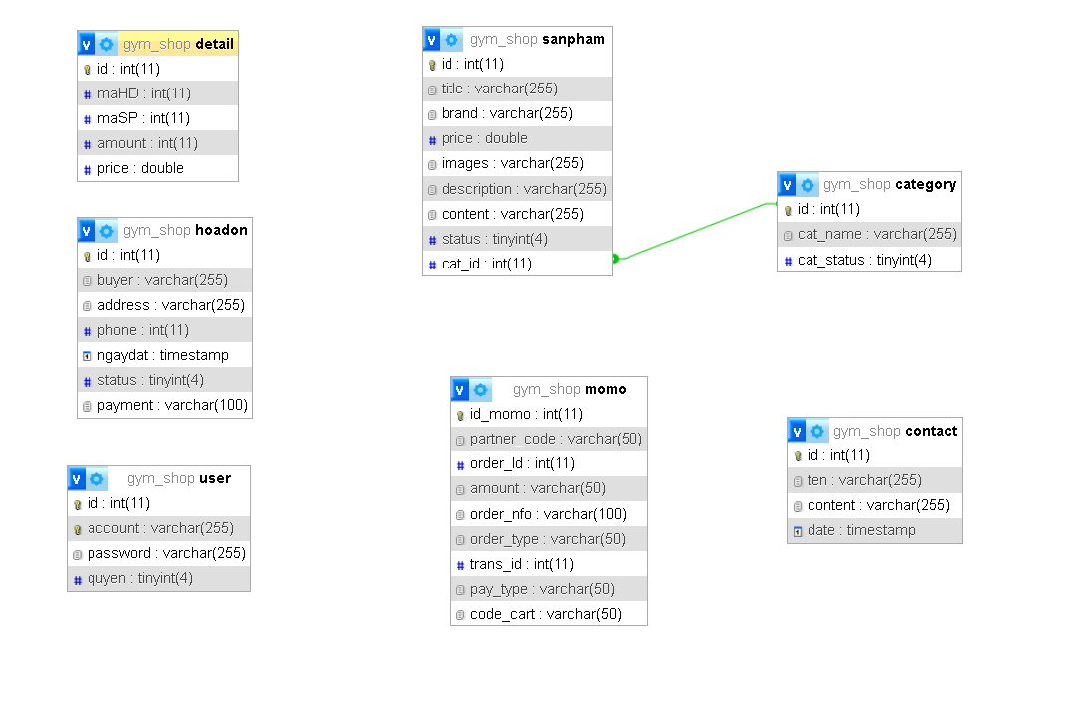

Slide 11
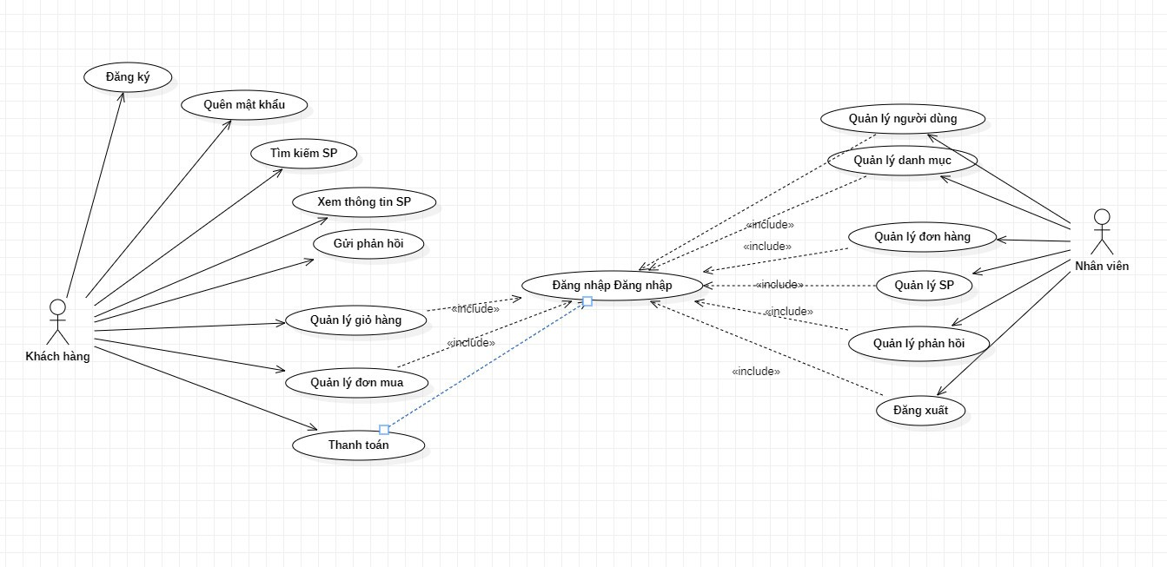
Use case

Slide 12

4
Demo

Slide 13

5.Summary
Easy to ues
User friendly
Catchy for user

Slide 14

6.improvements

Slide 15

Some flaws
Not dynamic completly
Not optimize
experience
Some part in the web is still static
Some function still slow
Poor managment and organize web

